Slide 1
Project 4: Facial Image Analysis with Support Vector Machines
Catherine Nansalo and Garrett Bingham

Slide 2
Outline
Introduction to the Data
FG-NET database
Support Vector Machines
Overview
Kernels and other parameters
Results
Classifying Gender
Predicting Age
Conclusions
Questions
References

Slide 3
Introduction to the Data: FG-NET
1002 images
0-69 years old
6-18 images per person
82 people
47 males
35 females
The FG-NET database is “...funded by the E.C.IST program. The objectives of FG-NET are to encourage development of a technology for face and gesture recognition.”
(See http://www-prima.inrialpes.fr/FGnet/)

Slide 4
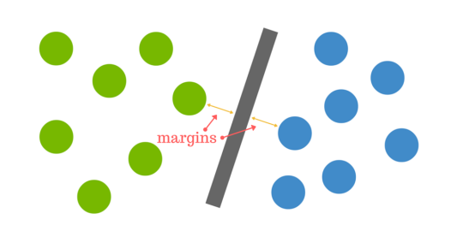
Support Vector Machine (SVM)
Finding the hyperplane that best divides data into classes
Support vectors are the points nearest to the hyperplane
The distance between the hyperplane and the nearest data point from either set is known as the margin.

Slide 5
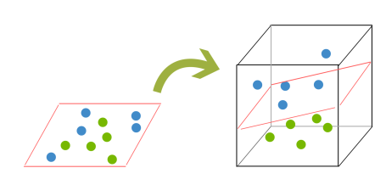
But what happens when there is no clear hyperplane?
2D higher dimension.
Kernalling!

Slide 6
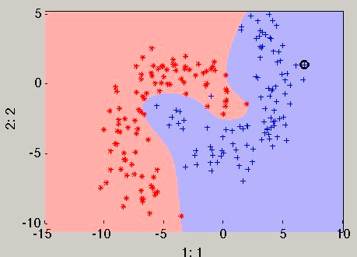
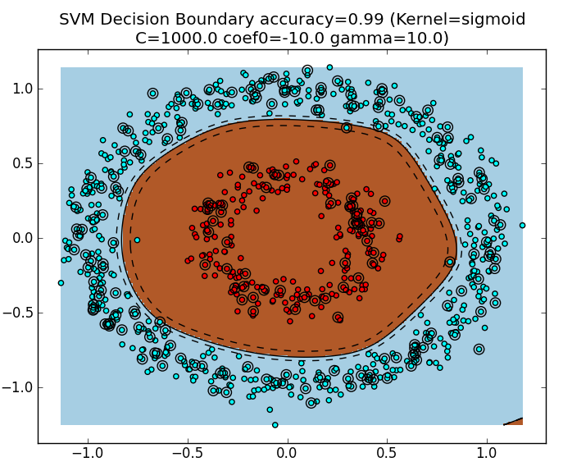
Linear
Polynomial
Radial

Slide 7
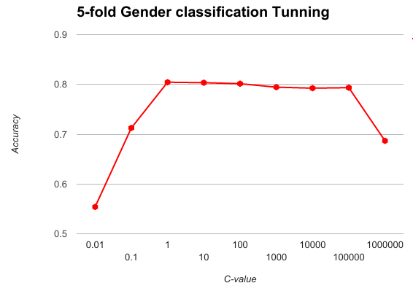
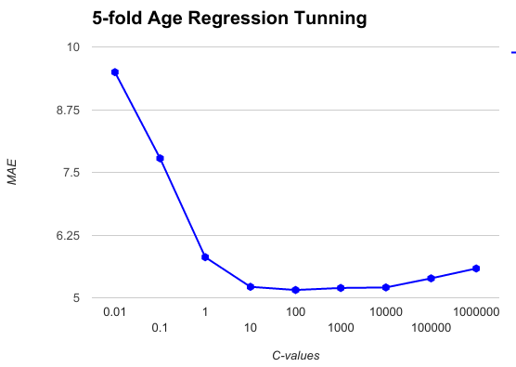
Results: Linear Kernel
Gender cost = 1
Age cost = 100

Slide 8
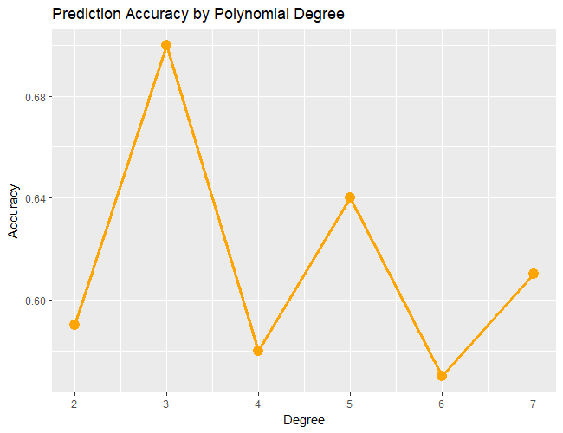
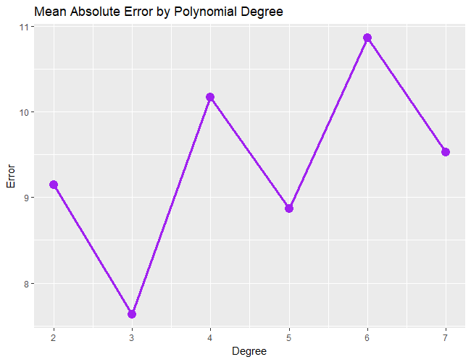
Results: Polynomial Kernel
Useful when the boundary separating theclasses is not linear
Optimal values for parameters are unknown, so a grid search tests different combinations and evaluates them using 5-fold cross validation.
Degree = 3 offers the highest accuracy in gender prediction as well as the lowest error in age estimation.

Slide 9
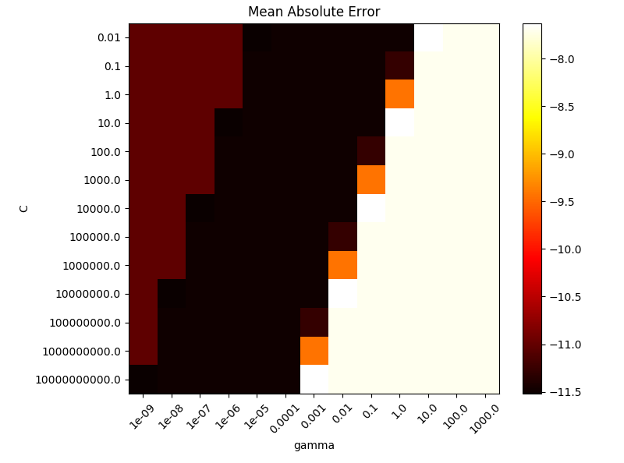
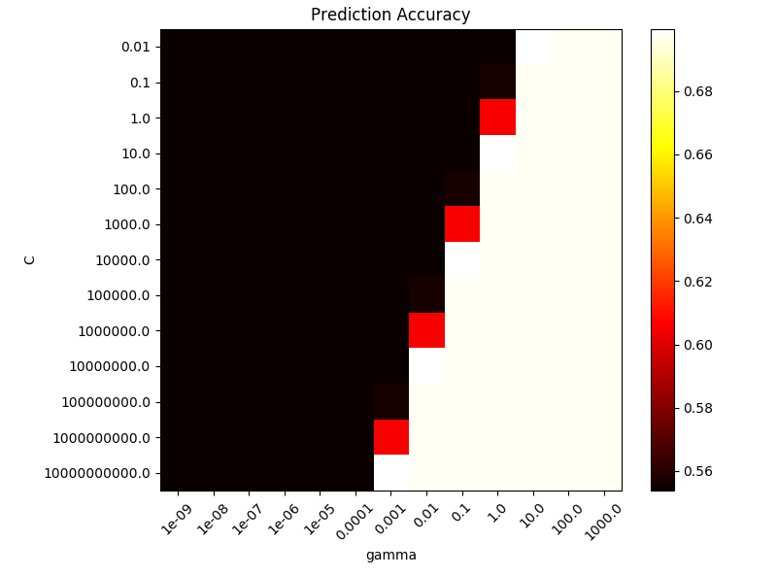
Support Vector Machines: Polynomial Kernel
The heatmaps show how different choices of C and Gamma affect model performance for gender classification and age
Best Parameters (for both models)
C = 0.01
Gamma = 10
Age Estimation
Mean Absolute Error = 7.63
Gender Classification
Prediction Accuracy = 0.70

Slide 10
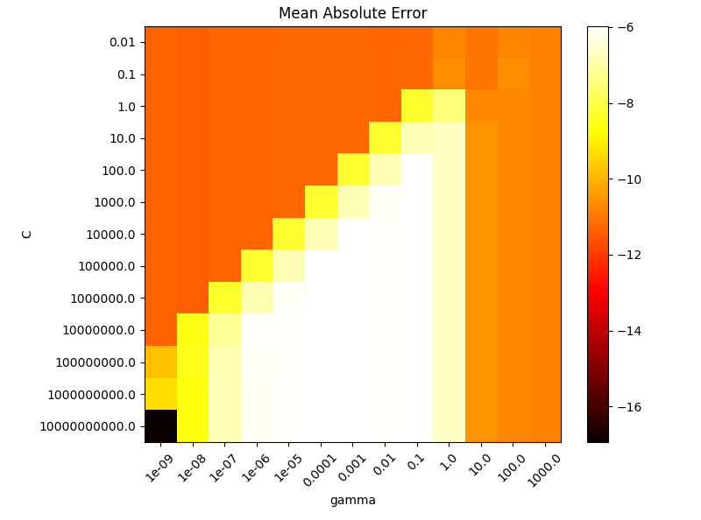
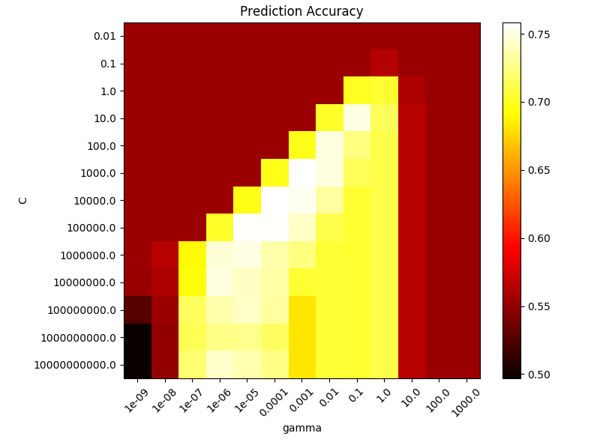
Support Vector Machines:
Radial Kernel
C: controls bias-variance tradeoff
Gamma: controls radius of influence of support vectors
Too large: includes only support vector itself, no regularization with C will prevent overfitting.
Too small: model is too constrained and can’t capture the complexity or “shape” of data.
Intermediate: model performs equally well with large C. The radial kernel acts as a structural regularizer, so it is not crucial to limit the number of support vectors.
Best values are found on the diagonal. Smooth models (lower gamma) are made more complex by selecting more support vectors (larger C).

Slide 11
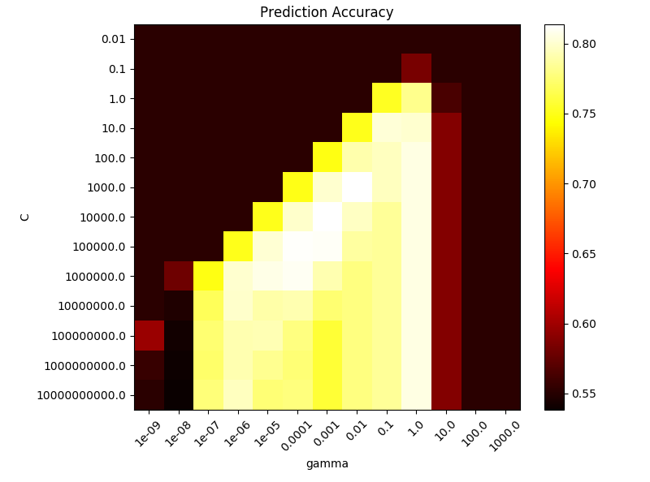
5-fold Cross Validation Comparison: Radial Kernel
Different methods of cross validation result in different recommended parameters. Not accounting for this could prevent our model from generalizing well to future data.
By image
Mean Accuracy: 0.81
C = 1000
Gamma = 0.01
By person
Mean Accuracy: 0.76
C = 1000
Gamma = 0.001

Slide 12
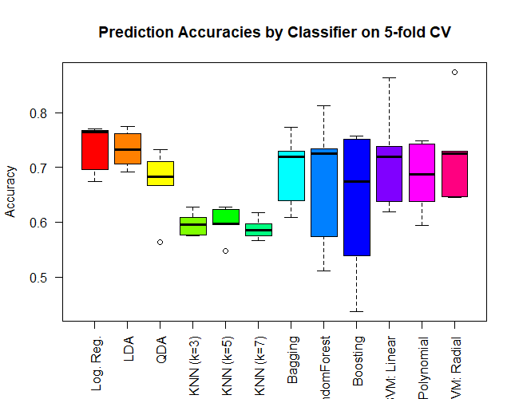
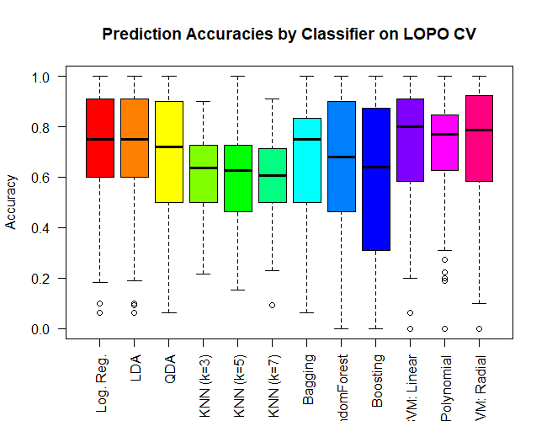
Results: Classifying Gender
 | Accuracy (5-fold CV) | Accuracy (LOPO CV)
Linear | 0.715 | 0.730
Polynomial | 0.682 | 0.719
Radial | 0.723 | 0.742
SVM performs slightly better than other classifiers we have tested in the past.

Slide 13
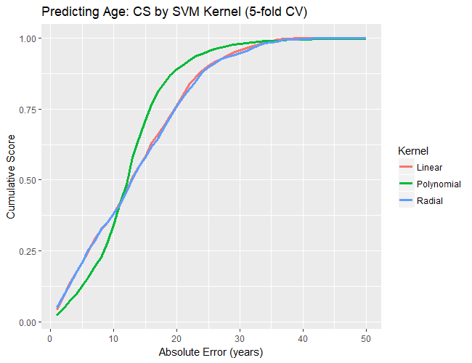
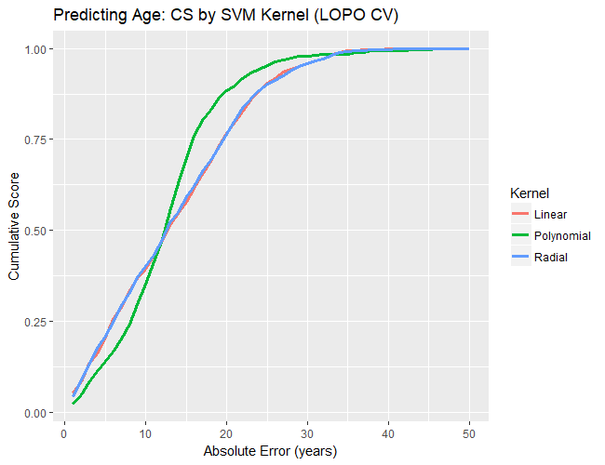
Results: Predicting Age
After tuning, the choice of kernel doesn’t seem to have a great affect on model performance.
The Cumulative Score (CS) is the proportion of the images whose predicted ages were within j years of their actual age.

Slide 14
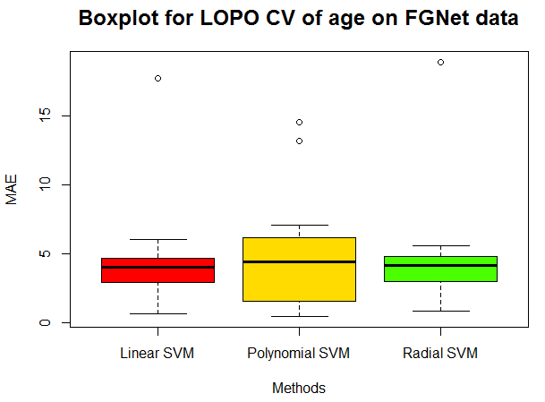
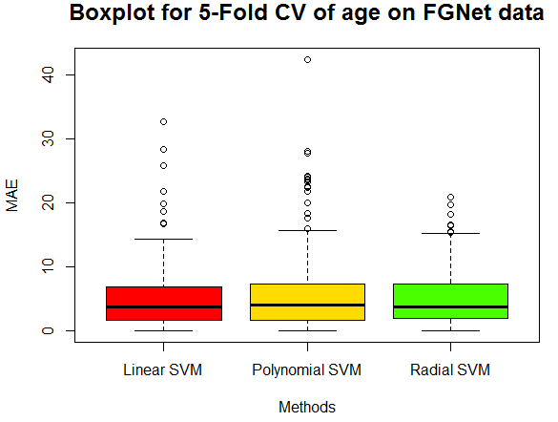
Results: Predicting Age
 | MAE (5-fold CV) | MAE (LOPO CV)
Linear | 4.172666 | 3.415833
Polynomial | 3.991509 | 4.845455
Radial | 3.989279 | 3.578097
The Mean Absolute Error (MAE) is the average difference between predicted age and actual age for all images.

Slide 15
Conclusions
Grid search is a useful tool to select optimal parameters for SVM
These parameters are sensitive to the method of cross validation
The method of cross validation can affect overall model performance
Different kernels are better suited to different problems

Slide 16
Questions
Does it matter whether the degree of the polynomial kernel is odd or even?
What happens as the degree of the polynomial kernel grows large?
Are there more efficient methods of parameter selection besides an exhaustive grid search?

Slide 17
References
http://scikit-learn.org/stable/auto_examples/svm/plot_rbf_parameters.html
Slide 3: https://www.researchgate.net/figure/220057621_fig1_Figure-1-Sample-images-from-the-FG-NET-Aging-database
Slides 4-5: http://blog.aylien.com/support-vector-machines-for-dummies-a-simple/
Slide 6: http://perclass.com/doc/guide/classifiers/svm.html , http://www.eric-kim.net/eric-kim-net/posts/1/kernel_trick.html
An Introduction to Statistical Learning with Applications in R by Gareth James, Daniela Witten, Trevor Hastie, and Robert Tibshirani.

Slide 18
Thank you!

