Slide 1
Week 2 Presentation:
Project 3
UNCW Statistical and Machine Learning REU, 2017
Garrett Bingham, Katie Kempfert, Diana Zamudio-Garcia
June 2, 2017

Slide 2
Facial Imaging Using the FG-NET Dataset
We considered the following two tasks for face images in the FG-NET dataset:
Age prediction
Gender classification
For each task, we used several approaches from statistical and machine learning.
We mostly focused on bagging, random forests, and boosting, but other approaches were used for comparative purposes.
Predicting Age and Classifying Gender

Slide 3
Outline of Presentation
Introduction to the Data
Prediction Models
Bagging
Random Forest
Boosting
Results and Comparisons
Predicting Gender
Predicting Age
Conclusions
References

Slide 4
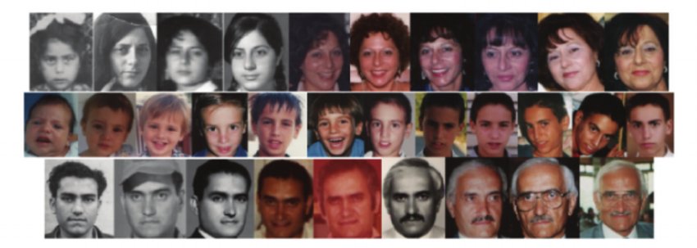
Intro to Data: FG-NET
1002 images
82 people
The FG-NET database is “...funded by the E.C.IST program. The objectives of FG-NET are to encourage development of a technology for face and gesture recognition.” (See http://www-prima.inrialpes.fr/FGnet/)
Image Source: https://www.researchgate.net/figure/220057621_fig1_Figure-1-Sample-images-from-the-FG-NET-Aging-database

Slide 5
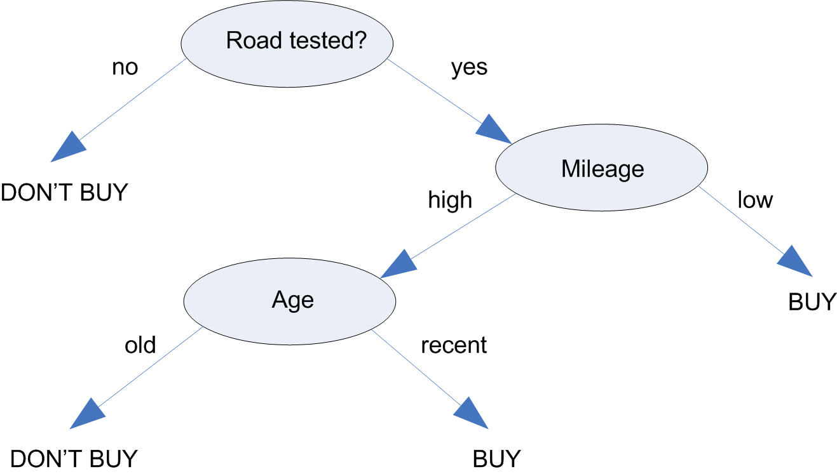
Motivations for Bagging, Random Forests, and Boosting -Decision Trees
Bagging, random forests, and boosting have a basis in decision trees.
Image Source: https://www.ibm.com/support/knowledgecenter/SS3RA7_15.0.0/com.ibm.spss.modeler.help/nodes_treebuilding.htm

Slide 6
Motivations for Bagging, Random Forests, and Boosting -Decision Trees
Decision trees have certain advantages, such as interpretability.
However, decision trees tend to be weak classifiers, meaning that the error rate tends to be only slightly better than random guessing.
By combining many trees, we can achieve a strong forest. This is a metaphor for an ensemble or fusion.
Bagging, random forests, and boosting involve a fusion of decision trees. Though they tend to be more complex than decision trees, they can produce much better results (lower classification error or MSE).

Slide 7
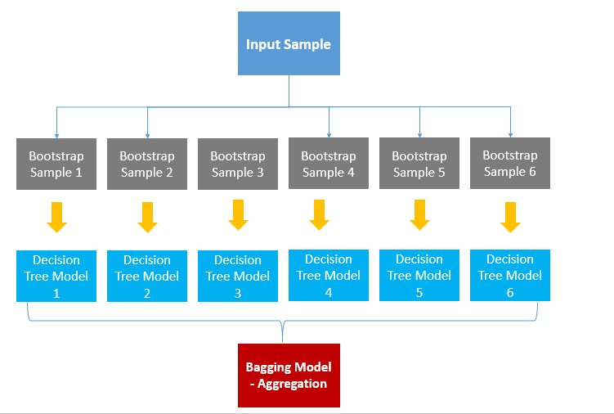
Bagging - Introduction
We would like to grow a larger number of trees based off the data, so that we can combine the results of all the trees..
In practice, we only have one dataset of size N.
We use the bootstrapping method of resampling to generate N “new” samples. A tree is grown for each bootstrapped sample. We make a prediction for a new observation using each individual tree.
The final prediction for the observation is determined through a fusion of the results from all the individual trees.
Image Source: http://dni-institute.in/blogs/bagging-algorithm-concepts-with-example/

Slide 8
Bagging - Advantages and Disadvantages
Advantages
Efficient on large datasets
More accurate than decision trees
Averaging results of many trees reduces variance
Disadvantages
More difficult to interpret than decision trees
Less clear which variables are of greatest importance for predicting the response
More computationally intensive than forming a single decision tree

Slide 9
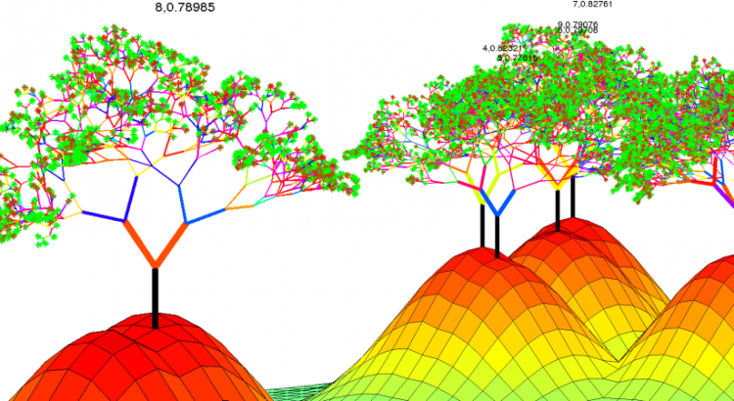
Random Forest - Introduction
Ensembles of decision trees
A special case of bagging
Like bagging, numerous trees are built independently of one another. A prediction is made for each tree. The final prediction is determined by combining the results from all the trees.
Unlike bagging, for each split in each tree, only a subset of predictors is considered.
The trees are less highly correlated, and a greater reduction in variance is achieved.
Image Source: http://paolaelefante.com/2016/03/random-forest-part1/

Slide 10
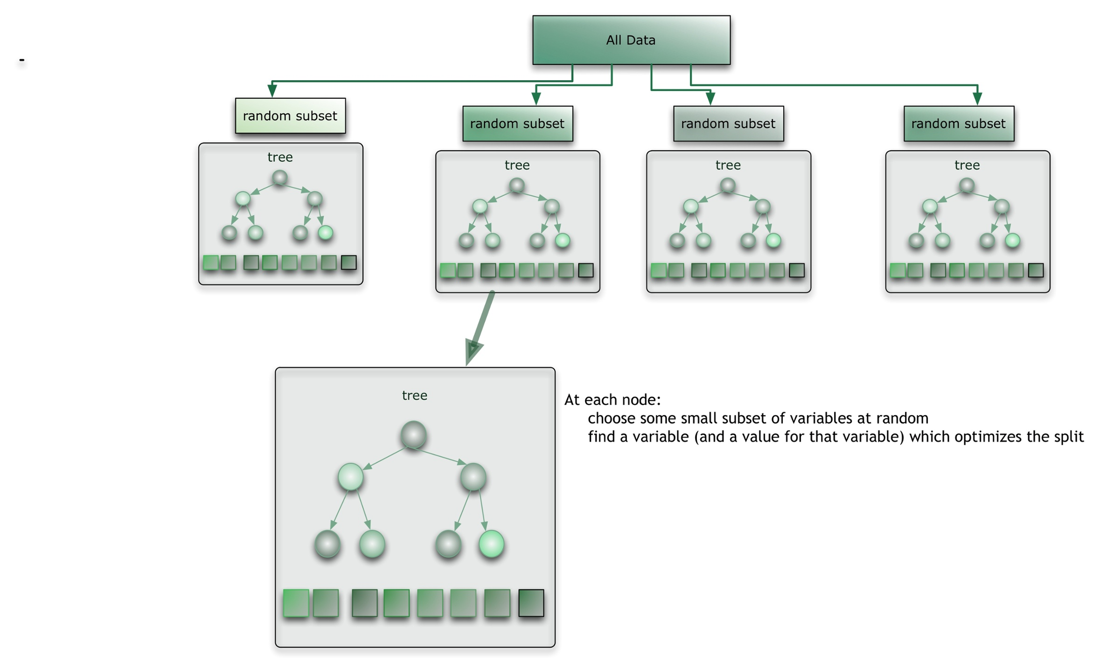
Source: http://blog.citizennet.com/blog/2012/11/10/random-forests-ensembles-and-performance-metrics

Slide 11
Random Forest - Why Not Bagging?
1. In statistical and machine learning problems, many variables are often considered as predictors of the response.
- However, typically only a minority of those variables are strong predictors.
2. Bootstrapped samples have been found to contain approximately 2/3 distinct values.
Suppose there is one predictor which is particularly dominant. Then 2/3 of the bootstrapped samples are expected to contain that dominant predictor. The first split of those trees will be along that variable, so those trees may look very similar and be highly correlated. Hence, the reduction of variance (a major goal of bagging) will not be as marked as we would hope.
The random forest attempts to overcome this problem by considering only a subset of predictors for each split. In this way, other predictors are “given a chance” and the reduction of variance from the ensemble is greater.

Slide 12
Random Forest - Advantages and Disadvantages
Advantages
Efficient on large datasets
Flexibly include missing data from previous node in the respective tree
Disadvantages
More accurate ensembles require more trees, which means building and testing the model is a slower process.
Like bagging, random forests are more difficult to interpret than decision trees.

Slide 13
Boosting- Introduction
In 1988, Kearns and Valiant proposed a fundamental question: "Can a set of weak learners create a single strong learner?"
In Robert Schapire's 1990 paper The Strength of Weak Learnability, he answered 'yes,' which led to the development of boosting.
The idea is that any weak classifier (one that performs only slightly better than chance) can be transformed into a strong classifier.
Since the 1990s, many algorithms have been developed for boosting.
What they all have in common is that they successively combine weak classifiers to create a strong classifier.
Unlike bagging and random forests, boosting is considered a slow learning approach.

Slide 14
Boosting - Classification with Binary Response
Suppose we have a new observation which we would like to classify into one of two groups, say 1 and -1.
Boosting sequentially builds trees on “new” sets of data. Ultimately, it produces a sequence of weak classifiers.
For each tree, a prediction is made based off the classifier.
The final prediction is obtained by taking a weighted majority vote from all the predictions.

Slide 15
Boosting - Classification with Binary Response
Weights are computed for each classifier in the sequence.
More accurate classifiers in the sequence are given higher weights, while less accurate ones have lower weights.
In this way, the most accurate classifiers have higher influence in the final prediction for the new observation.
For the first tree, the weights are set to be equal.
For the second tree, the weights are updated to reflect the classifications from the previous tree. Observations which were misclassified are given higher weight, while observations correctly classified are given lower weight.
For the mth tree, the weights are determined according to the the (m-1)th tree’s classifications. The process continues for all the trees.
In this way, the observations which are difficult to classify are given more “attention” and the overall accuracy improves.

Slide 16
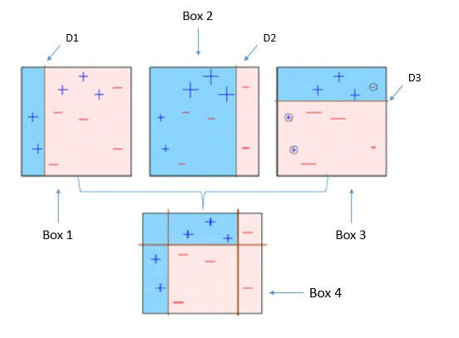
Boosting - Representation of Boosting Algorithm
Boxes 1-3 represent the first three trees grown. Box 4 represents the final tree, which is a fusion of the previous trees. A new observation will be classified according to the decision boundaries of Box 4.
Image Source: https://www.analyticsvidhya.com/blog/2015/11/quick-introduction-boosting-algorithms-machine-learning/

Slide 17
Boosting - Generalization
Boosting can also be used for regression problems.
Additionally, boosting can apply to classification problems with more than two groups.
Boosting works similarly for all these tasks.
Boosting algorithms mostly differ in their loss functions, which are optimized.
Perhaps the most famous boosting algorithm is AdaBoost, short for "Adaptive Boosting." The developers, Freund and Schapire, won the Godel Prize in 2003 for it. AdaBoost utilizes an exponential loss function.

Slide 18
Predicting Gender - Description
We predicted gender of subjects in the images in FG-NET using 109 b-vector parameters representing pixel information. We considered logistic regression, linear discriminant analysis (LDA), quadratic discriminant analysis (QDA), and k-Nearest Neighbors (KNN).
For each approach, we used two different cross-validation approaches: 5-Fold and Leave-One-Person-Out (LOPO).

Slide 19
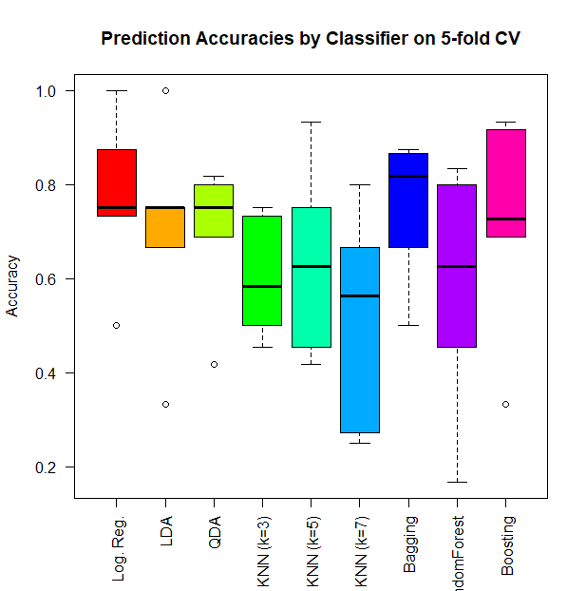
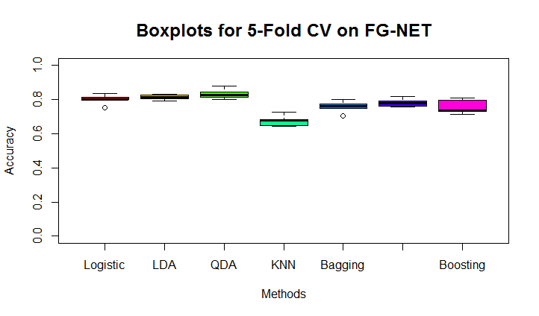
Predicting Gender - Graphical Comparison for 5-Fold CV
Results are very different.
RF
Katie
Garrett

Slide 20
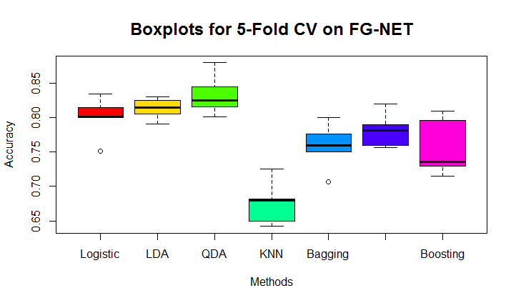
Predicting Gender - Rescaling Katie’s 5-Fold CV Results
RF

Slide 21
Predicting Gender - Tabular Comparison for 5-Fold
Method | Accuracy | Standard Deviation
Logistic Regression | 0.800 | 0.031
LDA | 0.813 | 0.016
QDA | 0.833 | 0.031
KNN (k = 3) | 0.684 | 0.036
KNN (k = 5) | 0.693 | 0.015
KNN (k = 7) | 0.691 | 0.023
Bagging | 0.754 | 0.035
RandomForest | 0.781 | 0.026
Boosting | 0.757 | 0.043
Method | Accuracy | Standard Deviation
Logistic Regression | 0.735 | 0.046
LDA | 0.734 | 0.035
QDA | 0.673 | 0.065
KNN (k = 3) | 0.597 | 0.022
KNN (k = 5) | 0.599 | 0.032
KNN (k = 7) | 0.589 | 0.020
Bagging | 0.660 | 0.051
RandomForest | 0.666 | 0.022
Boosting | 0.721 | 0.033
Katie
Garrett

Slide 22
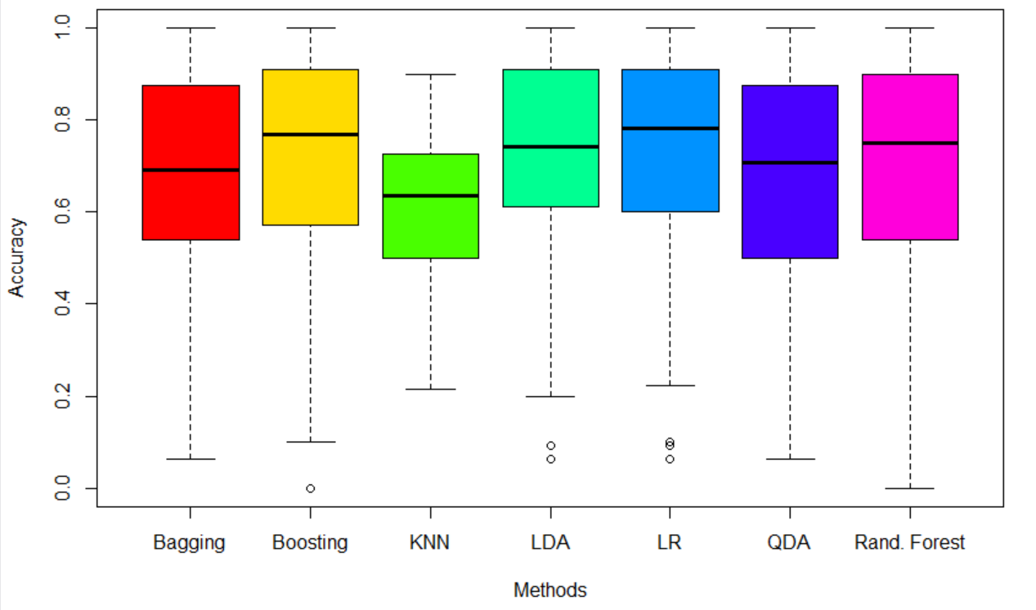
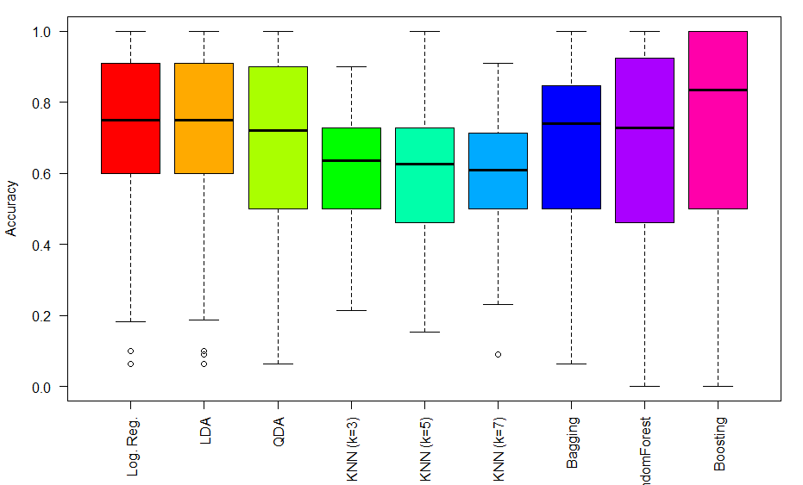
Predicting Gender - Graphical Comparison for LOPO CV
Results are quite similar.
Diana
Garrett

Slide 23
Predicting Gender - Tabular Comparison for LOPO CV
Method | Accuracy | Standard Deviation
Logistic Regression | 0.726 | 0.224
LDA | 0.718 | 0.237
QDA | 0.682 | 0.234
KNN (k = 3) | 0.606 | 0.168
KNN (k = 5) | 0.599 | 0.182
KNN (k = 7) | 0.589 | 0.173
Bagging | 0.684 | 0.035
RandomForest | 0.679 | 0.266
Boosting | 0.661 | 0.283
Method | Accuracy | Standard Deviation
Logistic Regression | 0.723 | 0.224
LDA | 0.713 | 0.237
QDA | 0.674 | 0.234
KNN (k = 3) | 0.600 | 0.168
KNN (k = 5) | 0.591 | 0.182
KNN (k = 7) | 0.583 | 0.173
Bagging | 0.681 | 0.214
RandomForest | 0.668 | 0.277
Boosting | 0.721 | 0.274
Katie
Garrett

Slide 24
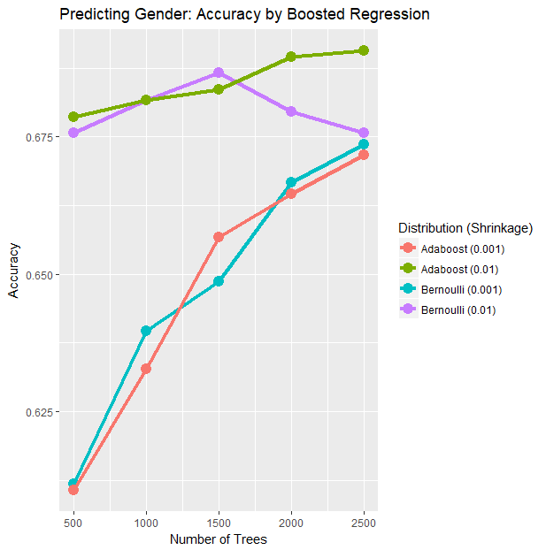
Predicting Gender - AdaBoost and Bernoulli Boosting Algorithms for Various Numbers of Trees
AdaBoost and Bernoulli boosting algorithms were used to predict gender using the 109 b-vector covariates.
Both models were evaluated with 5-fold CV.
Performance differs with shrinkage, which controls the rate at which the trees learn (slow vs. fast learning).
Overfitting?

Slide 25
Predicting Age - Description
We predicted numeric age of the subjects in the FG-NET dataset using 109 b-vector parameters as predictors. The methods we considered here were bagging, random forests, and boosting.
We used 5-Fold Cross-Validation and LOPO Cross-Validation for each method.

Slide 26
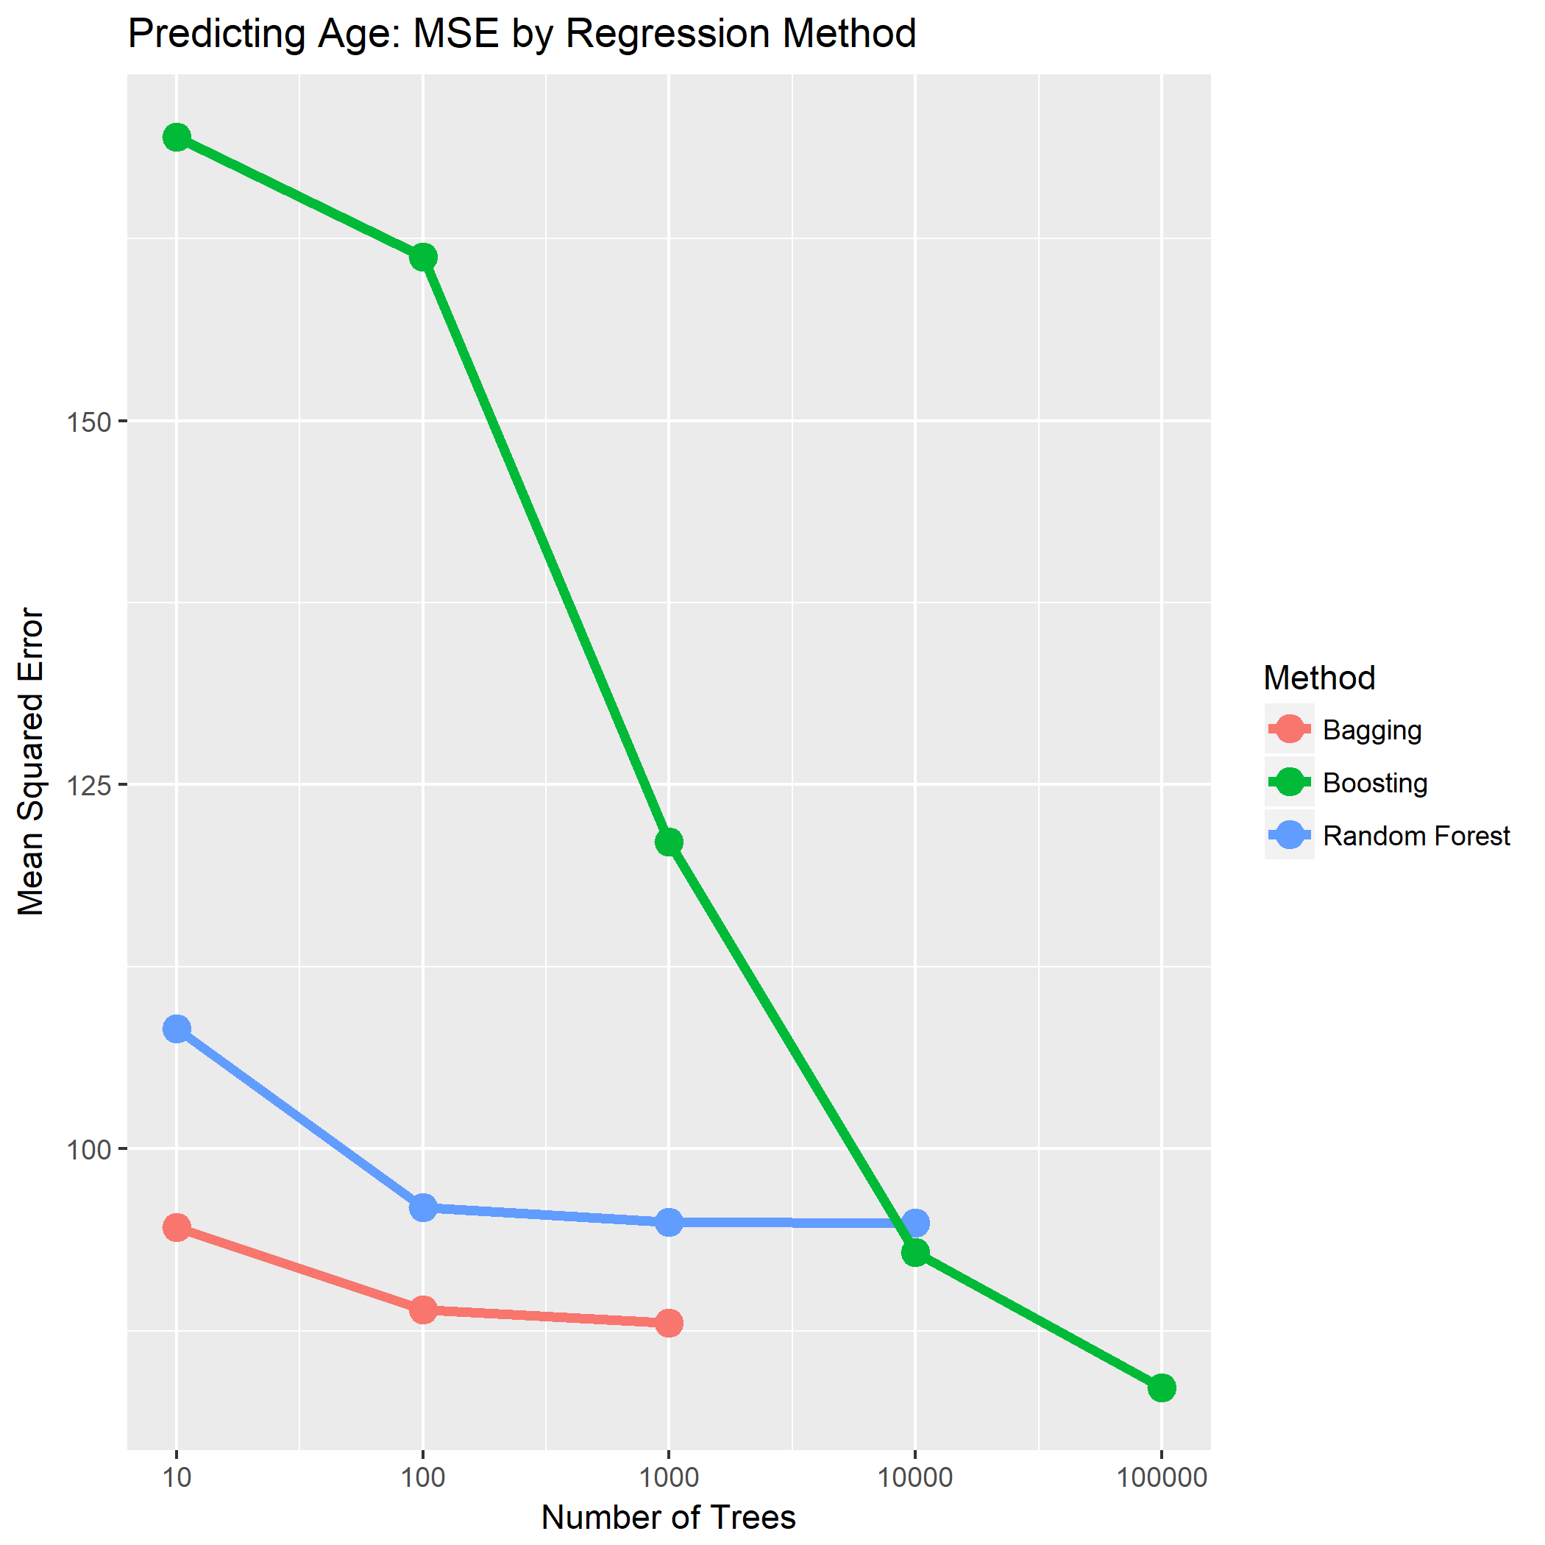
Predicting Age- Comparison of MSE by Regression Method
The bagging, boosting, and random forests methods were used to predict age for various tree sizes.
As the plot indicates, the MSE (calculated from 5-Fold Cross Validation) decreases as the number of trees increases.
The number of trees varies between methods due to computational challenges.

Slide 27
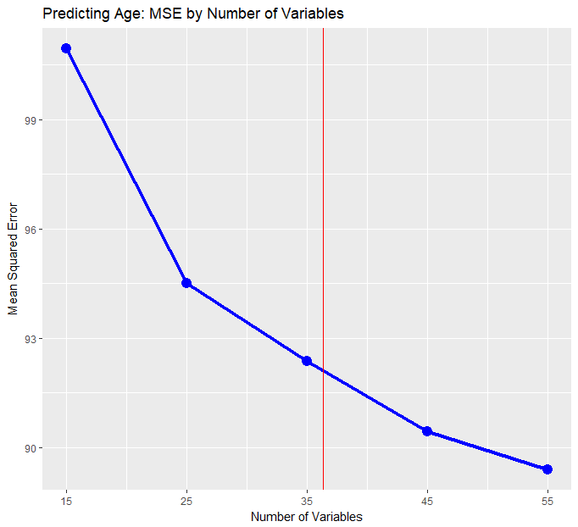
Predicting Age- Changing Number of Variables in Random Forest
Trees in a random forest are based on only some of the p total covariates.
For regression, typically p/3.
For classification, typically sqrt(p).
The red line represents p/3 = 36.3
We achieved higher performance with more predictors.
There is no ideal model for every problem.
Model selection is important.

Slide 28
Conclusions
Accuracies for LOPO tend to be much more stable than accuracies for 5-Fold CV.
The definition of the folds for 5-Fold CV has a notable effect on the results for gender classification on FG-NET.
Cross-validation is important when tuning parameters. Testing out different values for parameters can often yield improved results.
Differences in performance for AdaBoost, Bernoulli, and other boosting algorithms need to be further investigated.

Slide 29
Additional References
An Introduction to Statistical Learning with Applications in R by Gareth James, Daniela Witten, Trevor Hastie, and Robert Tibshirani.
The Elements of Statistical Learning by Jerome H. Friedman, Robert Tibshirani, and Trevor Hastie

Slide 30
Thank you for watching our presentation!
Questions?

